Slide 1


Slide 2

Index
Introduction
Background
Problem Statement
Methodology
Experimental Setup
Results
Conclusion
Future Work
Research Paper
References
00

Slide 3
Introduction
Epileptic seizures are sudden, uncontrolled electrical disturbances in the brain that can cause various symptoms, from brief lapses in awareness to severe convulsions.
Detecting these seizures accurately and promptly is crucial for effective medical intervention and patient care.
Traditional seizure detection methods rely on manual analysis of electroencephalogram (EEG) signals by medical professionals, which can be time-consuming and prone to human error. With advancements in artificial intelligence and deep learning, automated seizure detection systems using EEG data have emerged as a promising solution.
This study explores the use of deep learning models for extracting features and classifying epileptic seizures from EEG signals, utilizing the EEG Seizure Analysis Dataset(Kaggle).
01

Slide 4
Background
Epilepsy affects millions of people worldwide, making it one of the most common neurological disorders.
In recent years, machine learning and deep learning techniques have been increasingly applied to EEG-based seizure detection, aiming to improve diagnostic accuracy and reduce dependency on manual review.
LSTM networks capture sequential dependencies in EEG signals, while Autoencoders help in learning latent representations of the data.
Transformers, known for their self-attention mechanism, are useful for modeling long-range dependencies in time-series EEG data.
By leveraging these approaches, automated seizure detection systems can enhance clinical decision-making and provide real-time monitoring solutions for epilepsy patients
02

Slide 5
Problem Statement
Epilepsy is a neurological disorder that requires continuous monitoring for timely seizure detection and intervention. Traditional seizure detection methods rely on periodic EEG recordings analyzed manually by medical experts, making real-time monitoring challenging.
The manual interpretation of EEG signals is not only labor-intensive but also prone to misdiagnosis. Moreover, the absence of an efficient automated detection system limits the timely diagnosis and management of epilepsy.
To address these challenges, this project develops an automated seizure detection system using deep learning models, including LSTM, LSTM with Autoencoder, Transformer, and Inception V3. These models analyze EEG signals, extract meaningful features, and classify seizure and non-seizure events with high accuracy.
By integrating machine learning in seizure detection, this system aims to improve real-time monitoring, reduce dependency on manual review, and enhance patient care through timely alerts and interventions.
03

Slide 6
Methodology
The proposed system for automated epileptic seizure detection follows a structured approach to preprocess EEG data, extract meaningful features, and classify seizure events using deep learning techniques. The methodology consists of the following key steps:
Data Collection and Selection
Data preprocessing
Feature Extraction
Model Implementation
Model Evaluation and Validation
04

Slide 7
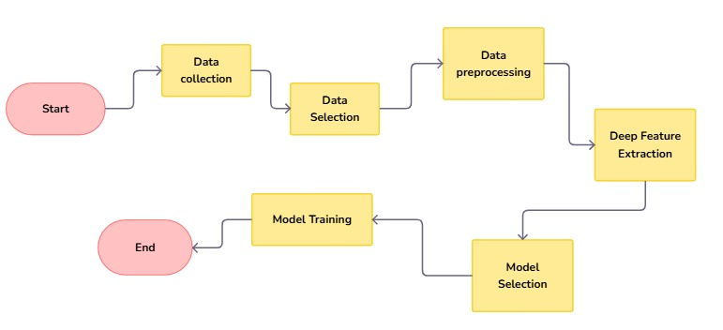
Flow -Chart

Slide 8
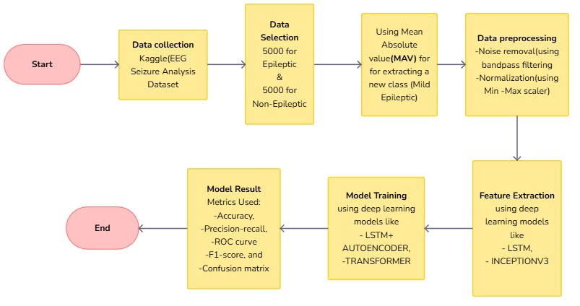
Architectural Diagram

Slide 9
Experimental Setup
The experimental setup consists of several stages, including data acquisition, preprocessing, model training, and evaluation. Each stage is designed to ensure the effectiveness of the deep learning-based seizure detection system.
Dataset Selection:
The EEG Seizure Analysis Dataset(Kaggle/Subset of CHB-MIT Scalp EEG Database) is used for training and evaluation. It contains EEG recordings from epilepsy patients, with seizure and non- seizure events labeled by experts.
05

Slide 10
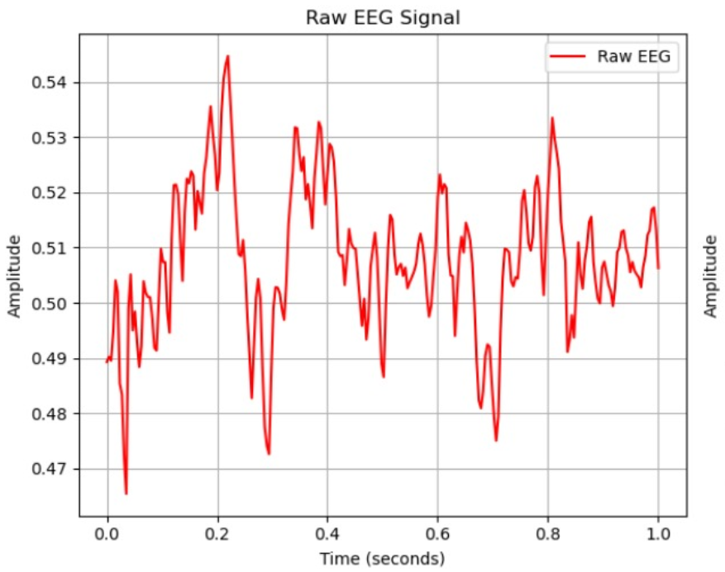
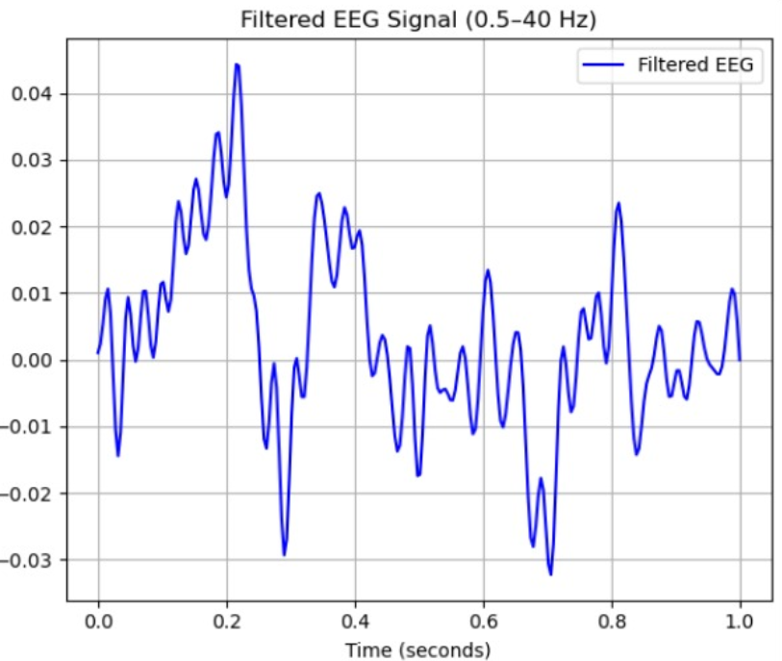
Experimental Setup
Data Preprocessing:
Normalization: Min-Max Scaling is used to scale all EEG signal values to a fixed range of [0,1]. This helps in improving the training stability and faster convergence of deep learning models.
Noise Removal: A bandpass filter is applied to remove unwanted frequencies and artifacts. It keeps only the signals within the range of 0.5 Hz to 40 Hz, which is the relevant frequency band for EEG data.
06

Slide 11
Experimental Setup
Feature Extraction:
Different deep learning models are used for feature extraction.
LSTM (Long Short-Term Memory)
Ideal for sequential data like EEG.
Captures temporal dependencies and learns patterns over time.
InceptionV3
Originally designed for image classification using CNN
EEG signals are reshaped as 2D representations for processing.
07

Slide 12
Experimental Setup
Model Training
Deep Learning Model used for training :
LSTM + Autoencoder
Learns a compressed representation of the EEG signals.
Useful for anomaly detection and noise reduction.
Transformer
Based on self-attention mechanisms.
Handles long sequences efficiently.
Performance Evaluation
Metrics Used: Accuracy, Precision recall, F1-score, and confusion matrix.
08

Slide 13
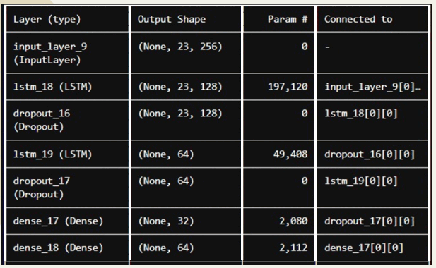
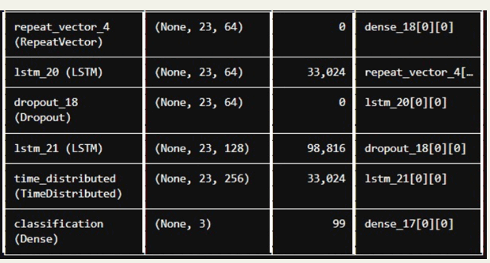
Experimental Results
Result optained using LSTM for feature extraction & LSTM+Autoencoder for model training.
Layers:
09

Slide 14
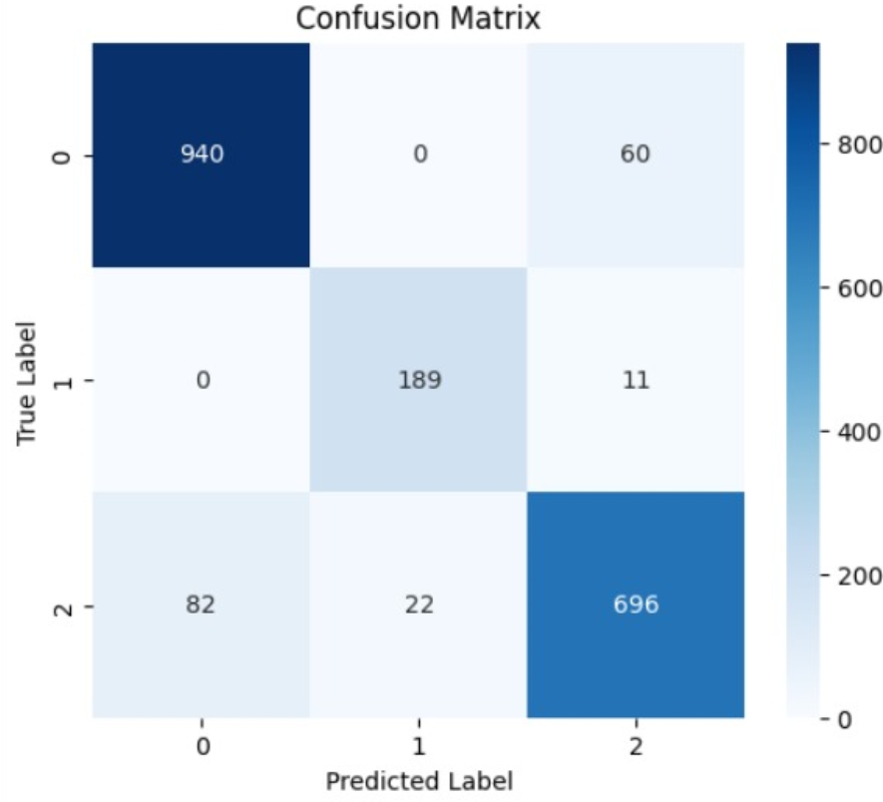
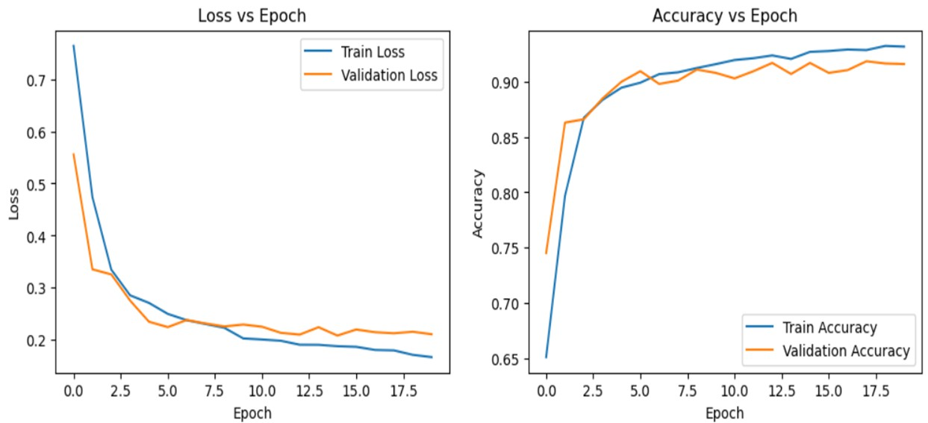
LSTM & LSTM+Autoencoder
The confusion matrix shows the model's classification performance. Here, class 0 and class 2 have high correct predictions.
The graphs show the model's training and validation loss decreasing
steadily, while accuracy improves and stabilizes above 90%.

Slide 15
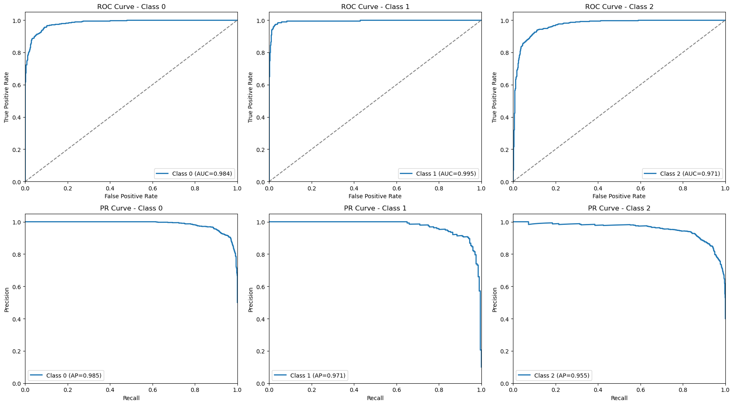
The graphs display ROC and Precision-Recall (PR) curves for three classes, showing strong model performance with high AUC and AP values, indicating excellent classification ability(LSTM & LSTM+Autoencoder).

Slide 16
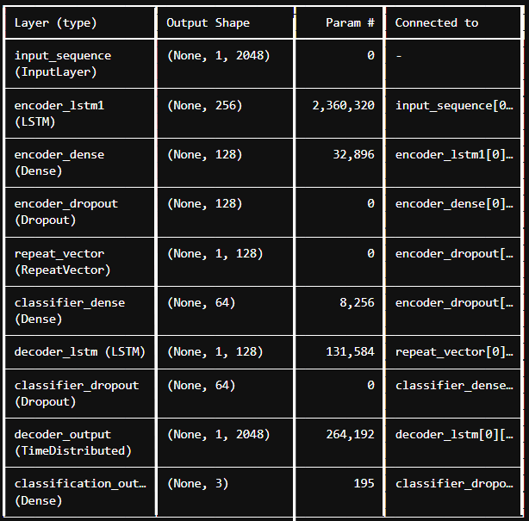
Experimental Results
Result optained using InceptionV3 for feature extraction & LSTM+Autoencoder for model training.
Layers:
10

Slide 17
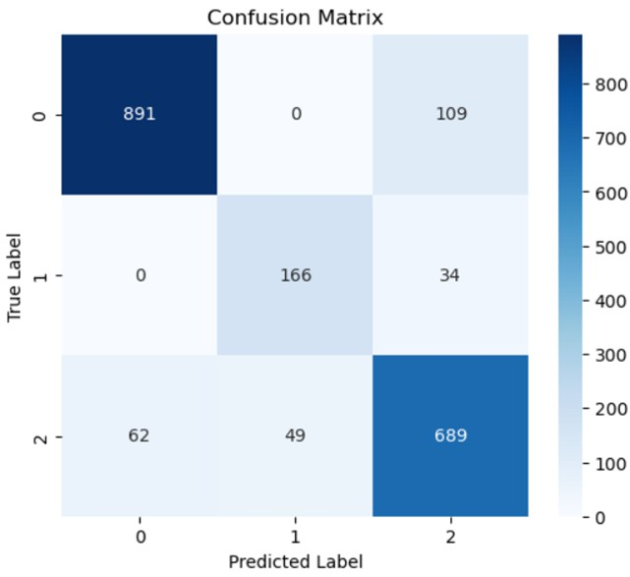
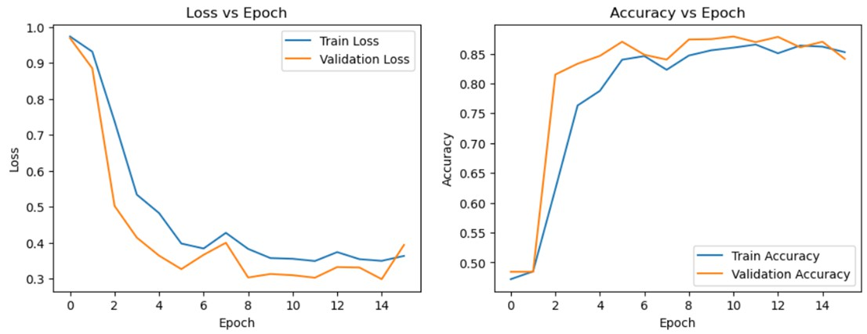
InceptionV3 & LSTM + Autoencoder
The confusion matrix shows the model's classification performance. Here class 0 and class 2 have high correct predictions
The graphs show the training and validation loss and accuracy. The loss decreases initially but fluctuates slightly towards the end, while accuracy improves significantly and stabilizes, indicating good model learning.

Slide 18
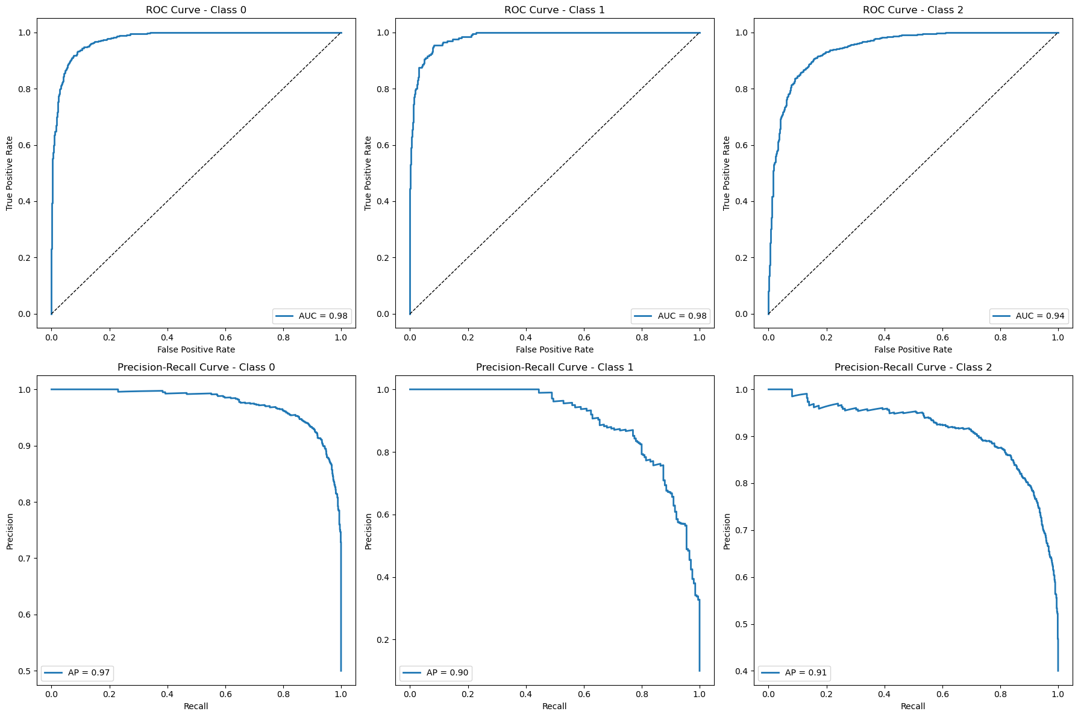
The graphs show the ROC and Precision-Recall curves for three classes, indicating the model's strong
classification performance (InceptionV3 & LSTM + Autoencoder).

Slide 19
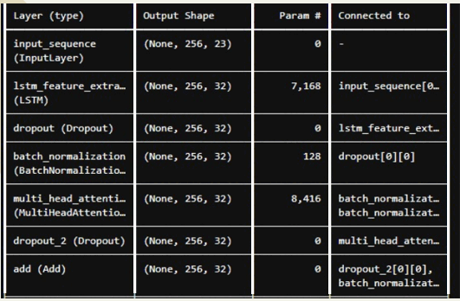
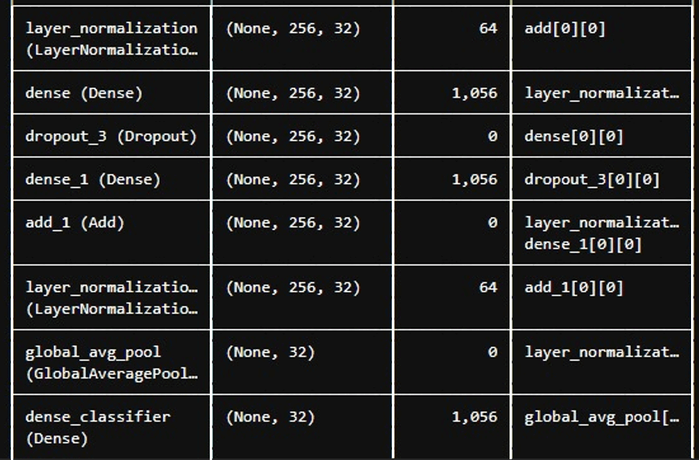
Experimental Results
Result optained using LSTM for feature extraction & Transformer for model training.
Layers:
11

Slide 20
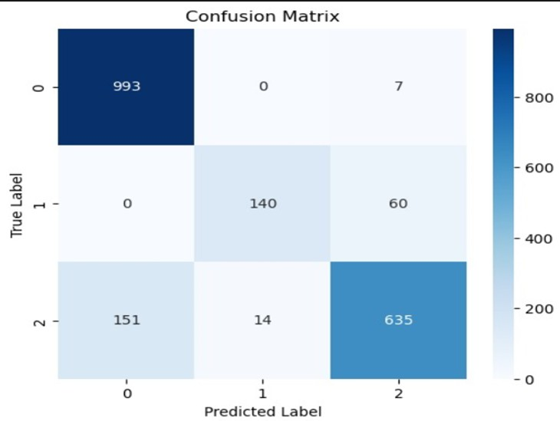
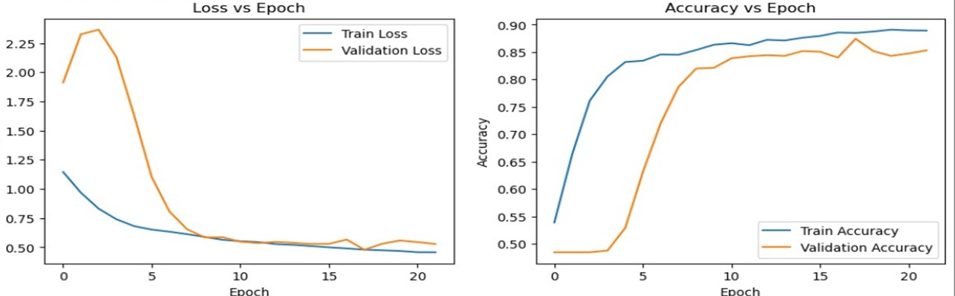
LSTM & Transformer
This confusion matrix shows the classification performance of the model, where class 0 is predicted with high accuracy.
The graphs illustrate the training and validation loss steadily decreasing over the epochs, while the accuracy consistently increases. This indicates that the models are learning effectively and improving performance as training progresses

Slide 21
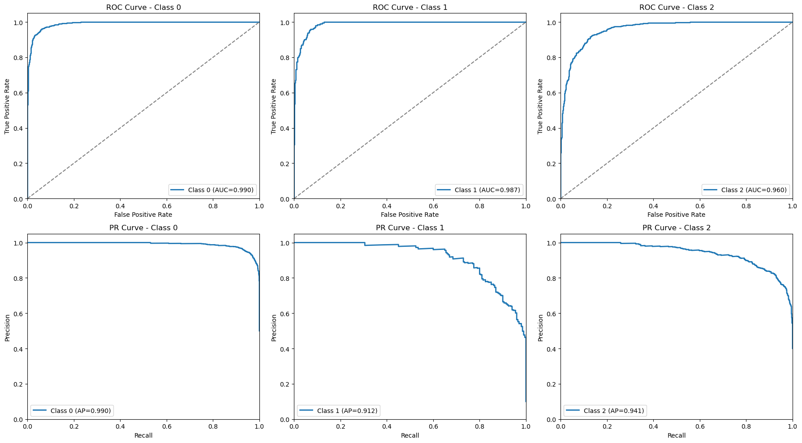
The graphs show ROC and Precision-Recall curves for three classes, with high AP values, indicating strong model
performance in classifying different seizure types (LSTM & Transformer).

Slide 22
Experimental Results
Result Obtained in Model Training
Feature extraction | Model training | Accuracy | Precision |  |  | Recall |  |  | F1 score
 |  |  | 0 | 1 | 2 | 0 | 1 | 2
LSTM | LSTM+Autoencoder | 92.71 | 92.00 | 90.00 | 91.00 | 94.00 | 94.00 | 87.00 | 91.00
InceptionV3 | LSTM+Autoencoder | 87.30 | 93.00 | 77.00 | 83.00 | 89.00 | 83.00 | 86.00 | 87.00
LSTM | Transformer | 88.91 | 86.80 | 90.91 | 90.46 | 99.30 | 70.00 | 79.37 | 88.40
12
Class 0- Non-Epileptic
Class 1- Epileptic
Class 2- Mild Epileptic

Slide 23
Conclusions
This project presents an automated epileptic seizure detection system using deep learning techniques to analyze EEG signals.
The system effectively captures temporal dependencies in EEG data, enhancing the accuracy of seizure detection.
The use of the EEG Seizure Analysis Dataset, combined with robust preprocessing, feature extraction, and model optimization, ensures reliable performance.
Experimental results demonstrate the potential of deep learning in real-time seizure monitoring, reducing the need for manual analysis and improving patient care.
1 3

Slide 24
Future Work
Develop a hybrid model combining different model like CNN, LSTM, and Transformers.
Explore advanced feature extraction methods for better EEG representation.
Improve model training and testing with larger datasets and optimization techniques.
14

Slide 25
Research paper
TITLE: Automated epileptic seizure detection from medical data using deep features extraction and learning algorithms(Writing started).
15

Slide 26
Reference
EEG Seizure Analysis Dataset:
https://www.kaggle.com/datasets/adibadea/chbmitseizuredataset
CHB-MIT Scalp EEG Database | Seizure Only:
https://www.kaggle.com/datasets/werus23/chb-mit-scalp-eeg-database-seizure-only
A hybrid CNN-Bi-LSTM model with feature fusion for accurate epilepsy seizure detection-Xiaoshuai Cao1 , Shaojie Zheng2 , Jincan Zhang2 , Wenna Chen1 and Ganqin Du1
Epileptic Seizures Detection Using Deep Learning Techniques: A Review-Afshin Shoeibi , Marjane Khodatars , Navid Ghassemi , Mahboobeh Jafari , Parisa Moridian, Roohallah Alizadehsani , Maryam Panahiazar , Fahime Khozeimeh , Assef Zare , Hossein Hosseini-Nejad , Abbas Khosravi , Amir F. Atiya , Diba Aminshahidi , Sadiq Hussain , Modjtaba Rouhani , Saeid Nahavandi and Udyavara Rajendra Acharya.
16

Slide 27

Thank You

